Slide 1
SOCIAL MEDIA ANALYSIS(FACEBOOK)
Provision of RFacebook page package which provides collection of R functions to access data from your face book social network: By Pablo Barbera.
To use RFacebook, you first need to sign up for a Facebook developer account, which is quick and easy as long as you already have a Facebook profile.

Slide 2
GROUP 3 MEMBERS
NAME | REG NO | STUDENT NO
ASINGWIRE DALLINGTON | 16/U/127 | 216000708
KALEMA ARNOLD | 16/U/5256/PS | 216003529
MUTUNGI DENIS SHARP | 16/X/2340/PS
NANJUKI SAIDAT | 16/U/9715/PS | 216017634

Slide 3
Why need to analyze facebook data
Needed for competitive gain analysis for the case of business enterprises.
Meet clients’ expectations
Draw future predictions d3epending on what has been analyzed.

Slide 4
Important packages
Devtools: make package development easier by providing R functions that simplify common tasks.
Rfacebook: access to facebook API via R,provides an interface to facebook API
Rcurl: client interface for R,provides great deal of control over APP protocols eg http
Rjson: converts R object into JSON objects,stores data as text in human readable format.
Tm :text mining from facebook
Wordcloud: needed for visual representation of text data.

Slide 5
Getting started with Rfacebook
- Graph API explorer ; tool that allows you to explore facebook’s social graph. Get data(user information,comments and photos)
-Generate authentication token that is necessary for using Rfacebook functions.
-once authenticated,Rfacebook functions can be used to query your friend list and get information about your friends.
There are two versions to connect to Facebook API that is
- via an app
-a temporary token (Duration of 2 hours)

Slide 6
Merits and demerits of each version
Using an app
-ADV: it is quite comfortable to connect to the API once the app is created.
-Disadv: Not all data available via this method
using token
adv: more data is available
disadv: limited for use in two hours.

Slide 7
Installing important package
Install.packages(“devtools”)
Install.package(“Rfacebook”)
Install.package(“Rcurl”)
Install.package(“JSON”)
Install.package(“xml2”)
Install.package(“tm”)

Slide 8
Connecting to the Facebook API via App:
-create an App on the Facebook platform.
-The App is used to connect to the Facebook API.
-To create a new app go to https://developers.facebook.com
This way you can manage your connections very good but it also has some disadvantages. Different than in version 1 of the API you can now just get information of the friends who are also using the app. This creates big problems as you can´t create a friend network with all you friends anymore.

Slide 9
Creating an App on Developers facebook platform
-To create a new app go to https://developers.facebook.com
-get started -if logged in,just enter app name
-create new app by adding display name and Contact email and then click “create App ID”
-app is then created.
-connect your R session with app created and authenticate it to our facebook profile for data mining.
-Rfacebook offers a function “fbOAuth” for that and is used as follows(example)
require("Rfacebook")
fb<- fbOAuth(app_id="123456789", app_secret="1A2B3C4D",extended_permissions = TRUE)
-The app id and app secret are obtained from your app settings on the Facebook developer page.

Slide 10
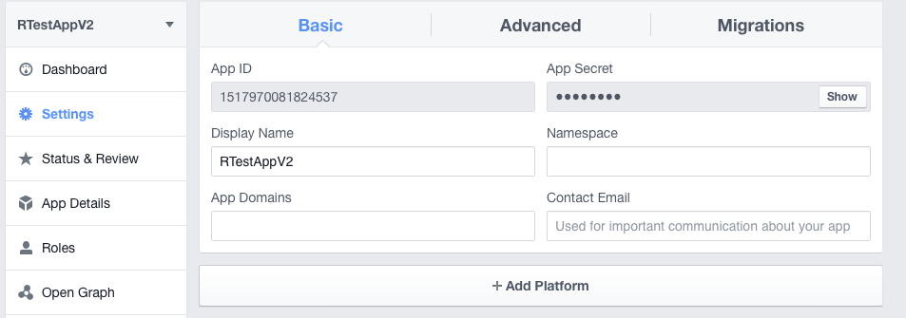
Output on console
The console will then print you the message:
Copy the URL and go to the settings of your Facebook app. Click on the settings tab on the left side and then choose “+ Add Platform“.

Slide 11
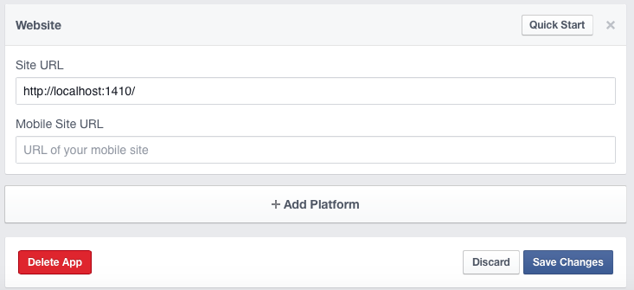
Then add the URL in the field “Site URL” and save the changes.
as

Slide 12

Output on console
Go back to your R session and hit enter. Then a browser window should open you have to allow the app to access your Facebook account.
If everything worked the browser should show the message
And your R console will confirm it with
You can then save your fb_oauth object and use it for the next time.
save(fb_oauth, file="fb_oauth") load("fb_oauth")
load("fb_oauth")

Slide 13
Analyze Facebook with R(using app information)
Now we connected everything and have access to Facebook. We will start with getting our own profile information.
As I mentioned before because of Facebook´s new API policies the information you can get is very limited compared to the amount you were able to download with apps using API 1.
So I will just show you now how to get your own personal information but other posts will follow with new use-cases of the new API version.
The getUsers function returns public information about one or more Facebook user. If we use “me” as the username argument, it will return our own profile info.
me <- getUsers("me",token=fb_oauth)

Slide 14
Getting information
Now we saved our own public information in the variable „me“ and you can take a look at it.
An advantage of the new API version is that you can get more than 100 likes. You can get the things you liked with:
my_likes <- getLikes(user="me", token=fb_oauth)

Slide 15
Connecting to the Facebook API via Authentication Token
The connection via an manually created authentication token has some less restrictions and so you can get more data. However, this token is only valid for 2 hours.
You can create your token at https://developers.facebook.com/tools/explorer

Slide 16
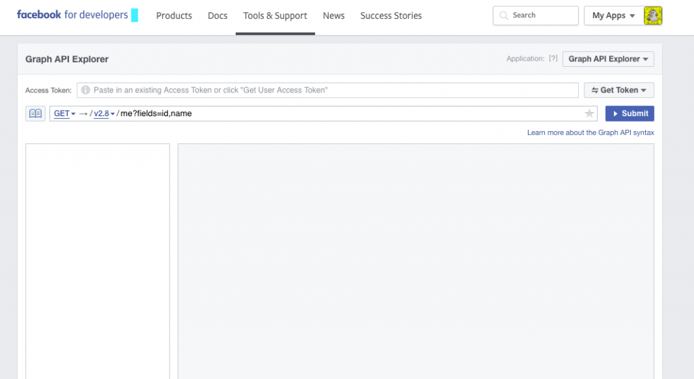
View
..

Slide 17
Analyze Facebook with R(using token)
token <- 'YOUR AUTHENTICATION TOKEN'
me <- getUsers("me", token, private_info=TRUE)
getUsers(c("barackobama", "donazdtrump"), token)

Slide 18
Accessing page information
-get page using getpage function
-parameters:
Page id(numeric id) ,obtained from https://findmyfbid.com where you enter the URL of the page you want to get information to analyse.
Page token, which is obtained from https://developers.facebook.com/tools/explorer
Number of posts(n) of the page to be accessed.

Slide 19
Accessing page information
p_token<-”your authentication token"
Variable<-getPage(page ID/name,p_token,number_of_posts,optional parameters)
page_info<-getPage(652353544896735, p_token, n = 25, since = NULL, until = NULL, feed = FALSE, reactions = FALSE, verbose = TRUE, api = NULL)

Slide 20
Accessing user information
token <- 'your authentication token'
me <- getUsers("me",token,private_info=TRUE)
my_likes <- getLikes(user="me", token=token)

Slide 21
Use of certain functions
Corpus- main structure for managing documents in tm(text mining)
tm_map function is used for transformations,maps a function to all elements of the corpus.
TermDocumentMatrix: approach to create a term document matrix from a corpus, displays a sample whereas as.matrix() yields the full matrix in dense format.
Par() creates a matrix of nrows and ncols plots that are filled in by row.

Slide 22
Visualizations
Wordcloud; visual representation of text data.
Histogram
Scatterplot
Bar graph
Pie chart

